Slide 1
Exploiting Perceptual Anchoring for Color Image Enhancement
第12組：黃湛元
黃煜堯
曾勁凱
教授：陳宏銘 教授

Slide 2
Outline
Exploiting Perceptual Anchoring for Color Image Enhancement
Gamma Correction – CIELUV & HSV & YCrCb & RGB
Model Analysis - CIELAB & HSV
HSV Enhancement
Low Light Enhancement
Color Correction
Color Correction + SLIC + CIECAM02

Slide 3
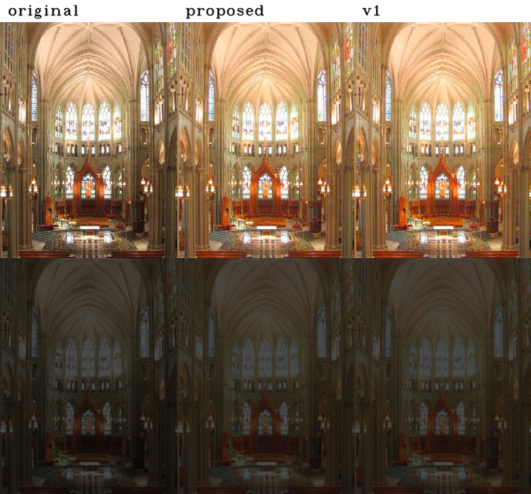
Exploiting Perceptual Anchoring for Color Image Enhancement

Slide 4
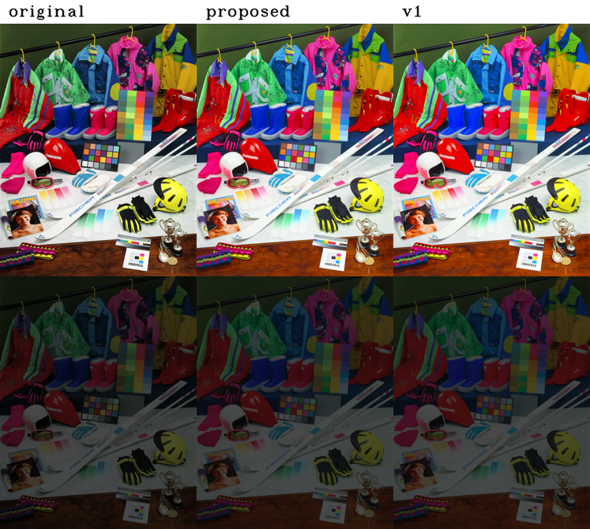
Exploiting Perceptual Anchoring for Color Image Enhancement

Slide 5
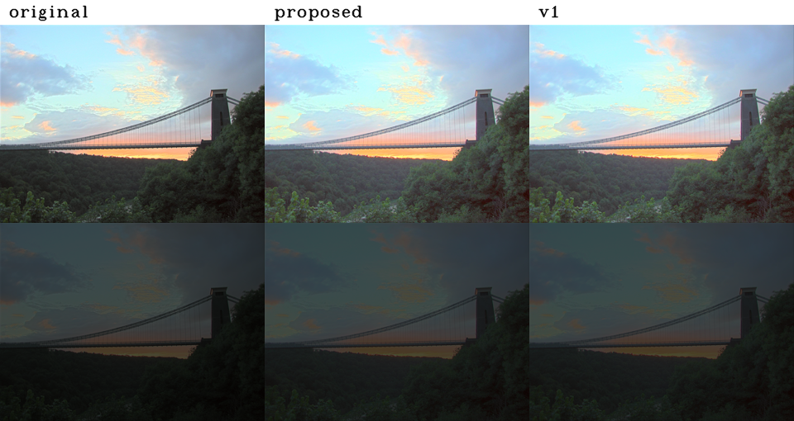
Exploiting Perceptual Anchoring for Color Image Enhancement

Slide 6
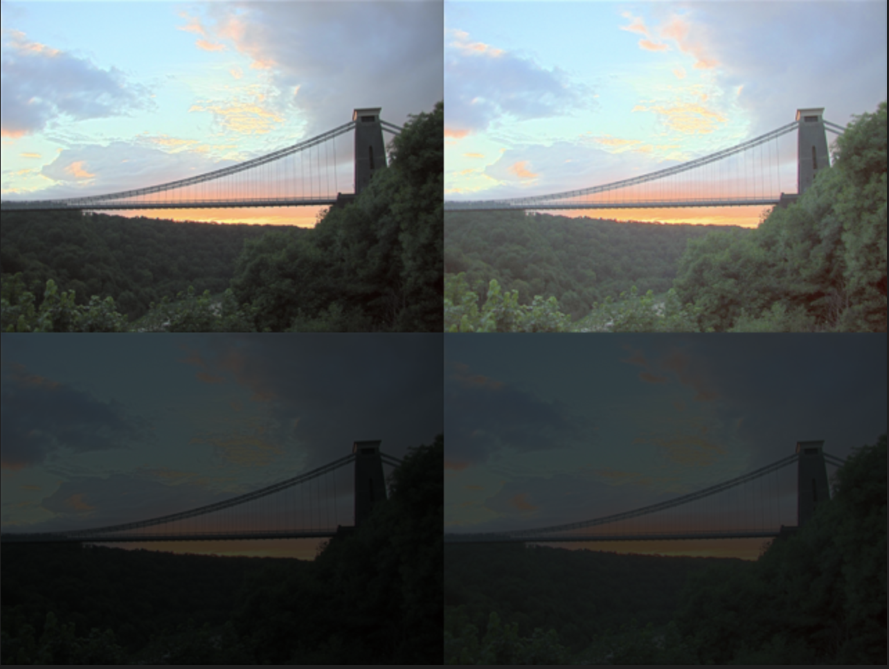
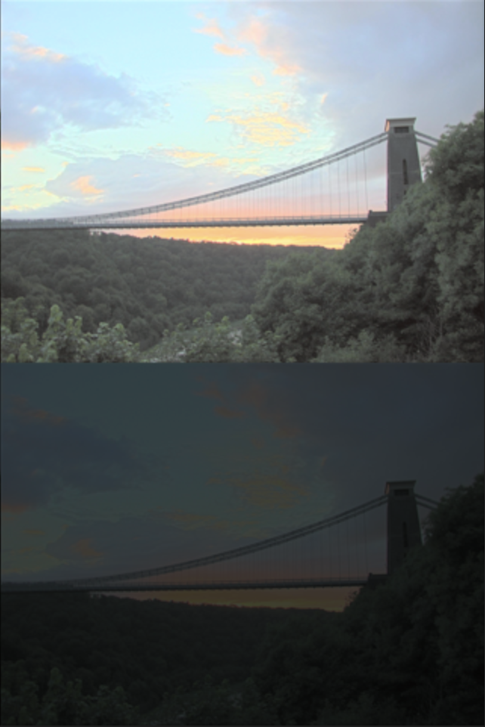
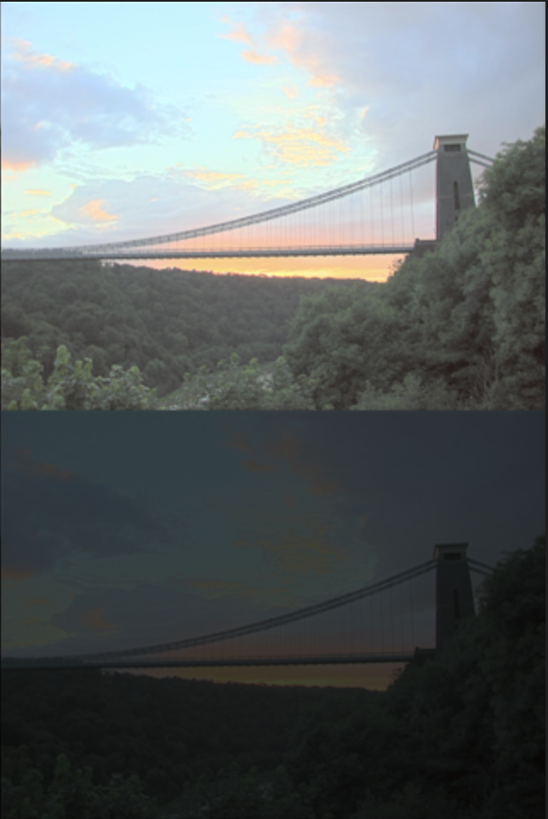
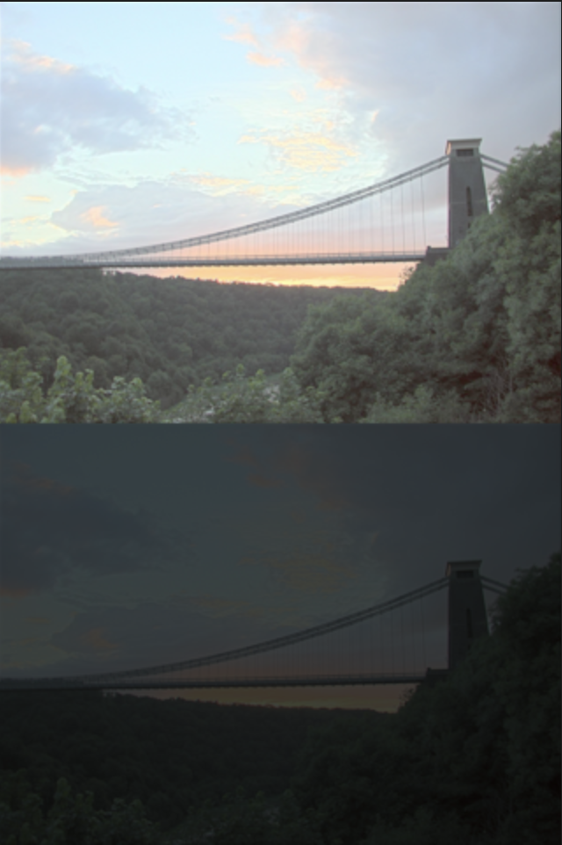
Gamma Correction
original
HSV
CIELUV
YCrCb
RGB

Slide 7
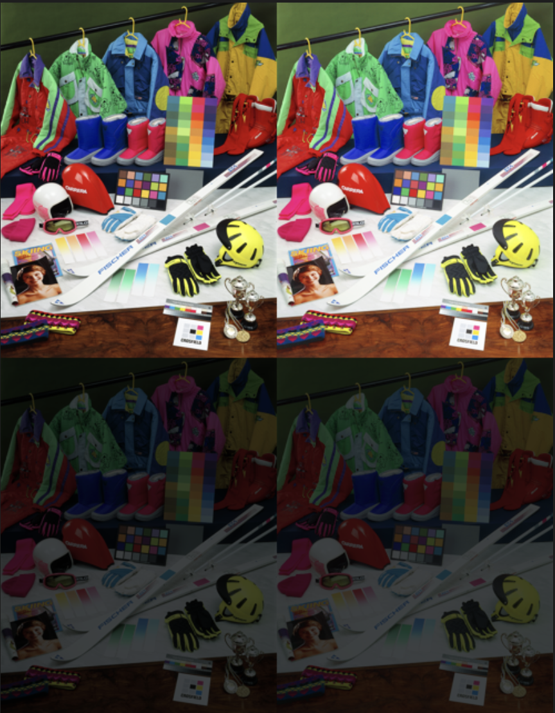



Gamma Correction
original
HSV
CIELUV
YCrCb
RGB

Slide 8
Model Analysis - CIELAB
L*a*b* model (L=1~100)
Fits within the gamut (r g b : 0~255)
難しすぎる…

Slide 9
Model Analysis - HSV
HSV model (V=1~100) (r g b : 0~255)

Slide 10
Model Analysis - HSV
Acceptable white area
acceptable

Slide 11
HSV Enhancement - Local Gamma Correction
S, V

Slide 12
HSV Enhancement - Linear Normalization
H
H=0
H=1

Slide 13
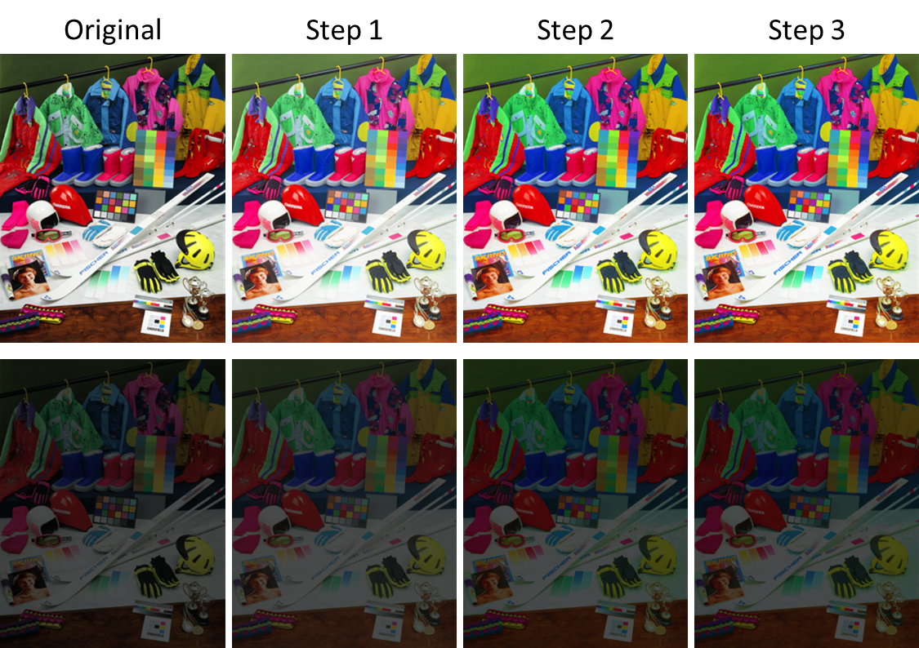
HSV Enhancement

Slide 14
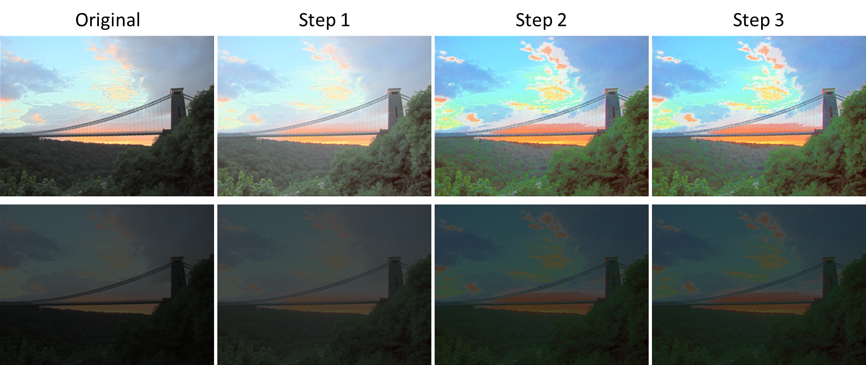
HSV Enhancement

Slide 15
Low Light Enhancement
Original
Step 1
Step 2
Step 3
Step 1 ：Invert the image
Step 2 ：Reduce the haze
Step 3 ：Invert the result in Step 2

Slide 16
Low Light Enhancement
Original
Step 1
Step 2
Step 3

Slide 17
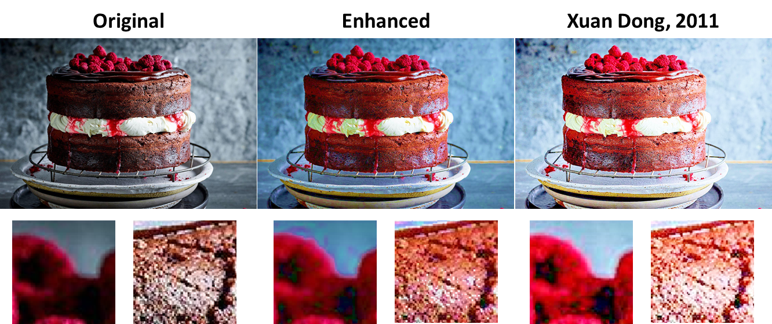
Low Light Enhancement

Slide 18
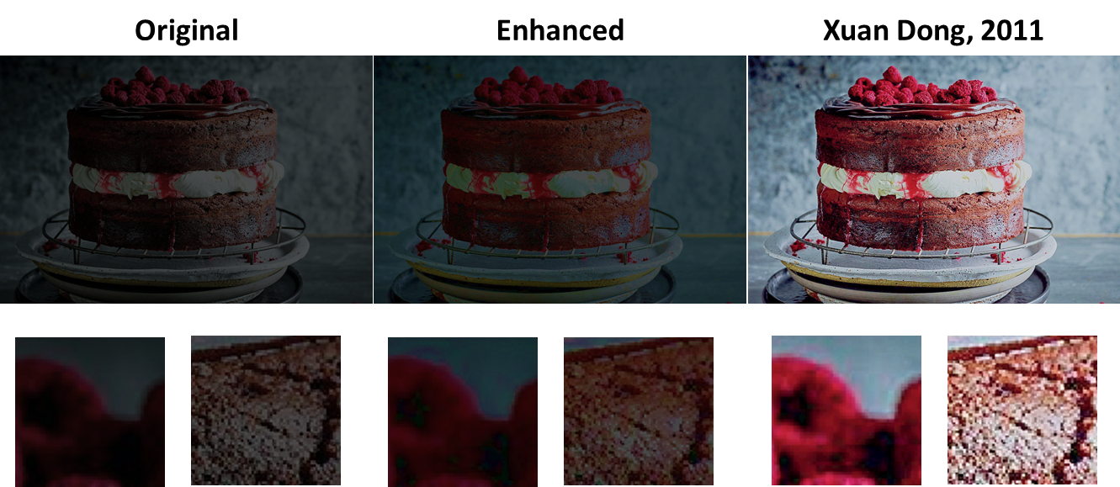
Low Light Enhancement

Slide 19
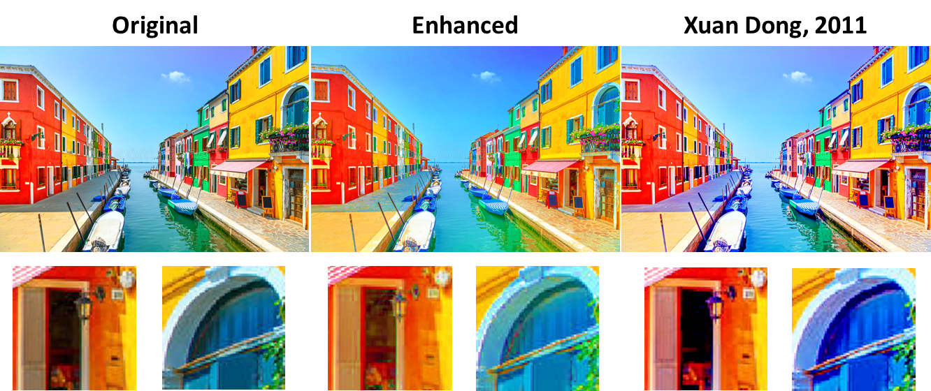
Low Light Enhancement

Slide 20
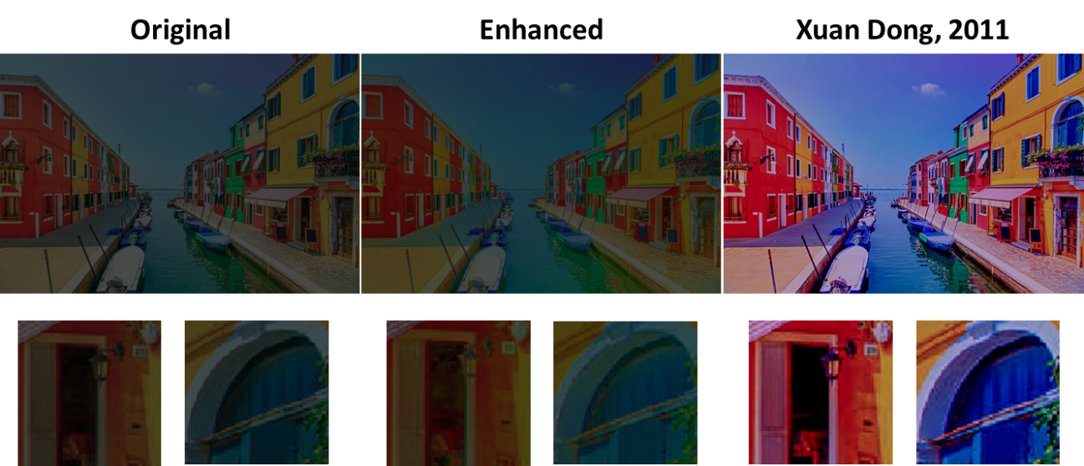
Low Light Enhancement

Slide 21
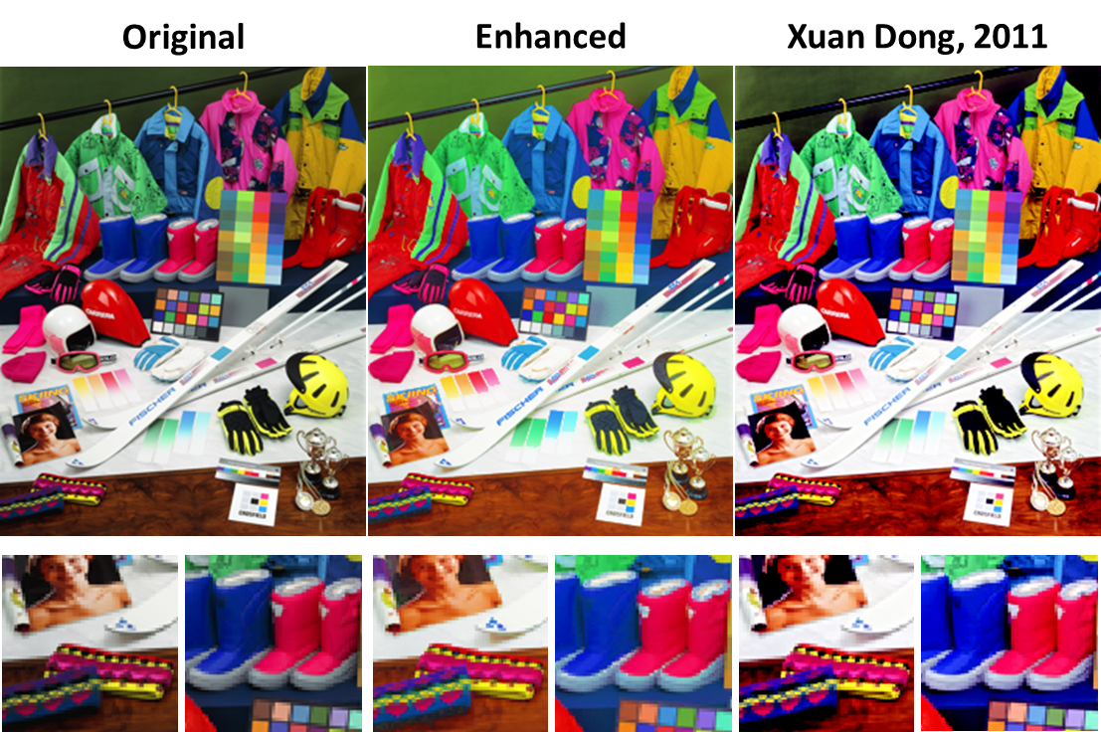
Low Light Enhancement

Slide 22
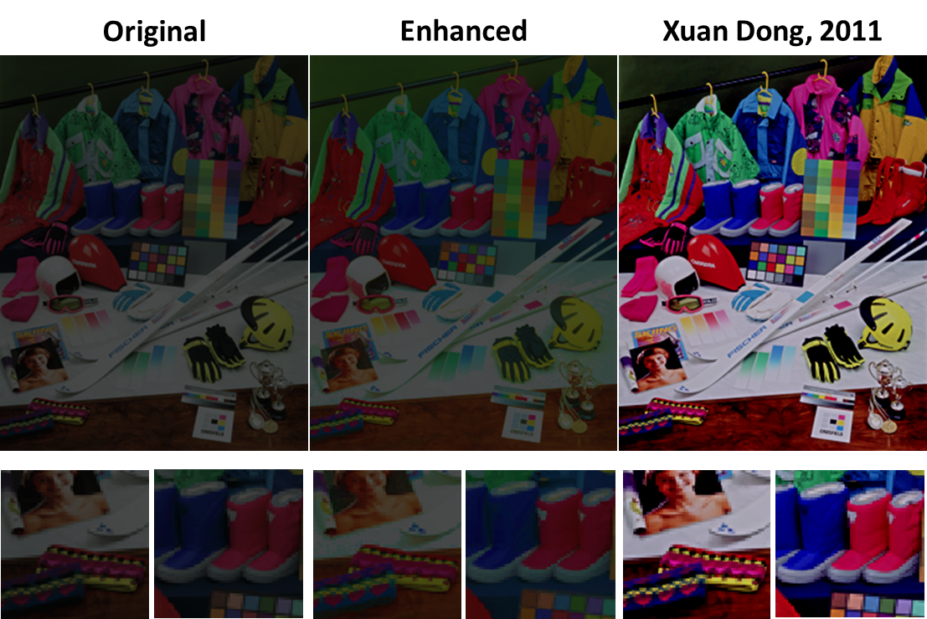
Low Light Enhancement

Slide 23
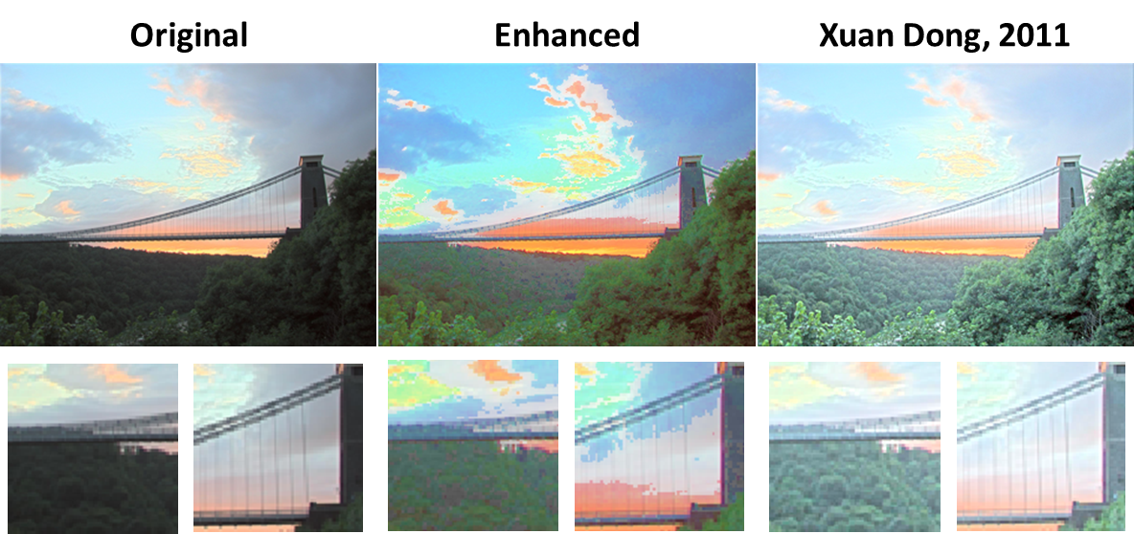
Low Light Enhancement

Slide 24
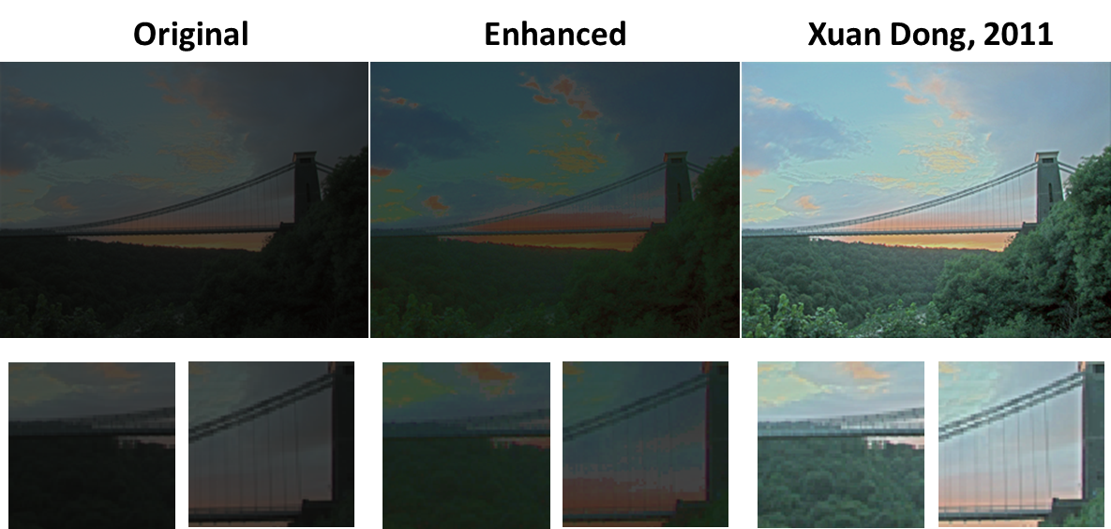
Low Light Enhancement

Slide 25
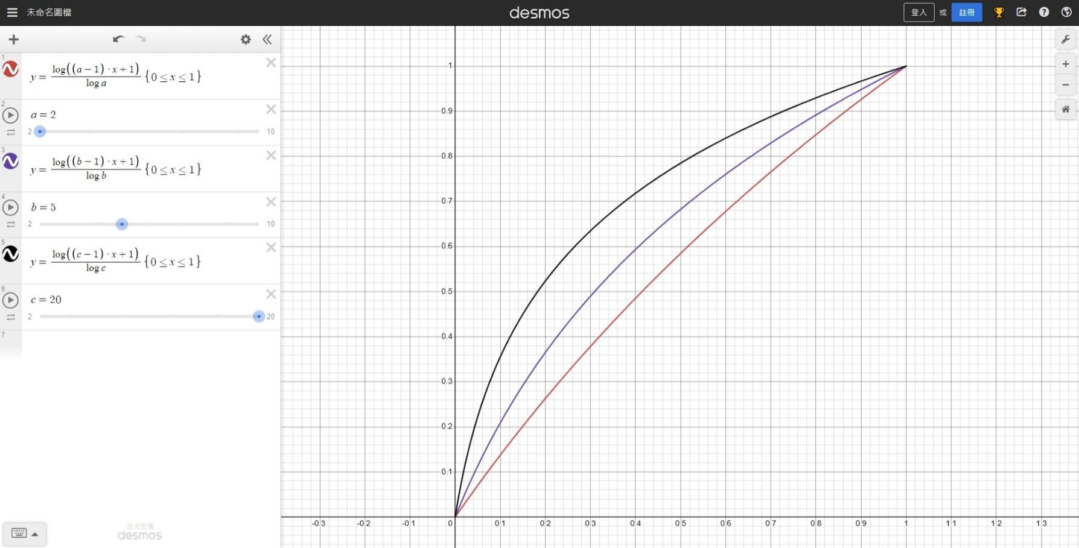
Color Correction

Slide 26
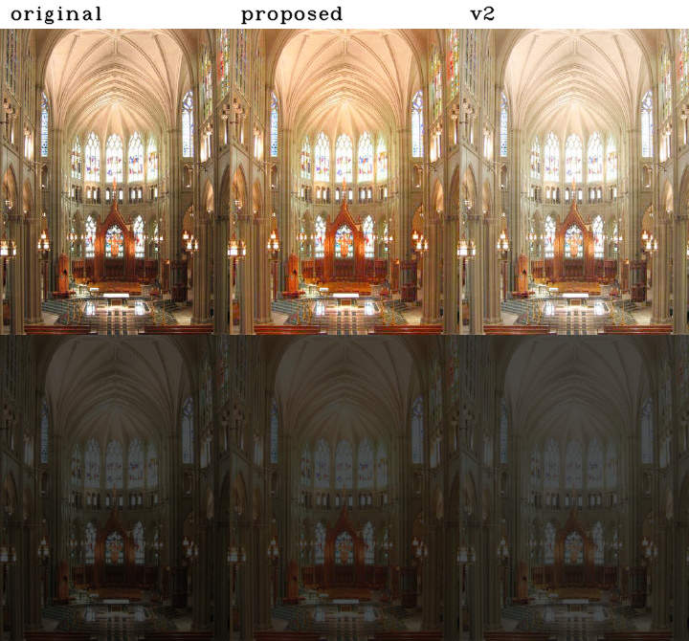
Color Correction

Slide 27
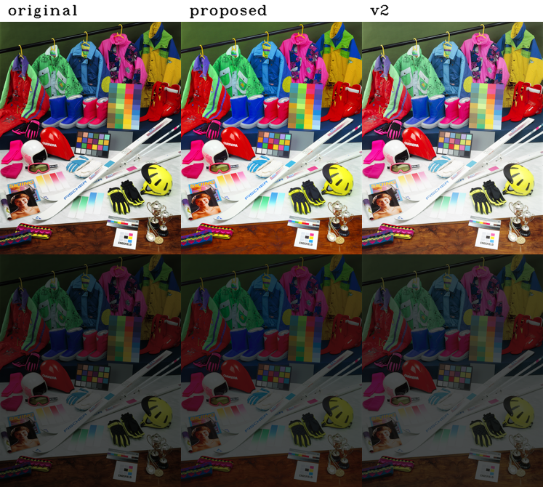
Color Correction

Slide 28
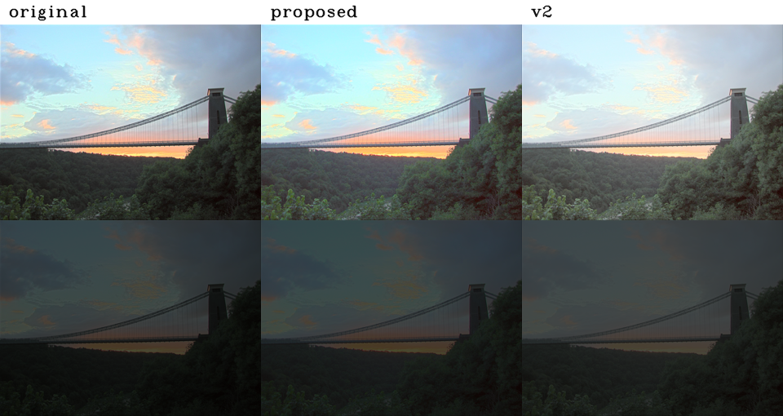
Color Correction

Slide 29
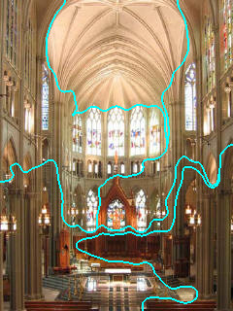
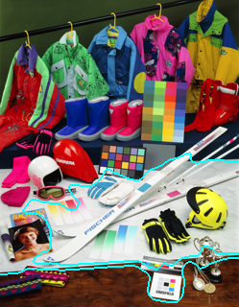
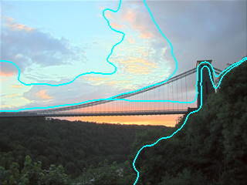
Color Correction + SLIC + CIECAM02
SLIC – super-pixel segmentation – mean color
Use CIECAM02 to get lightness J and chroma C
Set a = np.sqrt(1/(J*C))

Slide 30
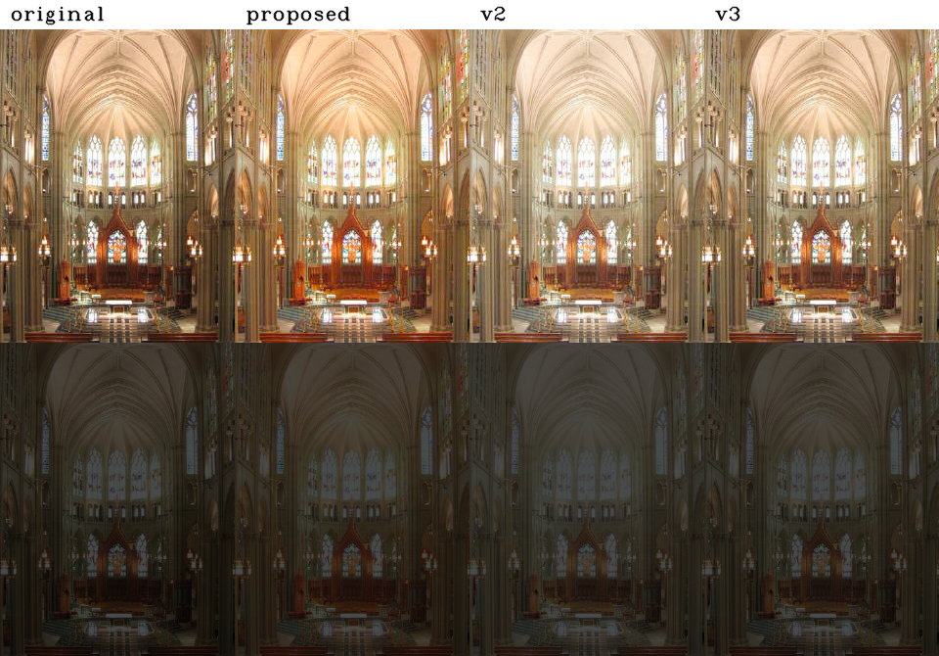
Color Correction + SLIC + CIECAM02

Slide 31
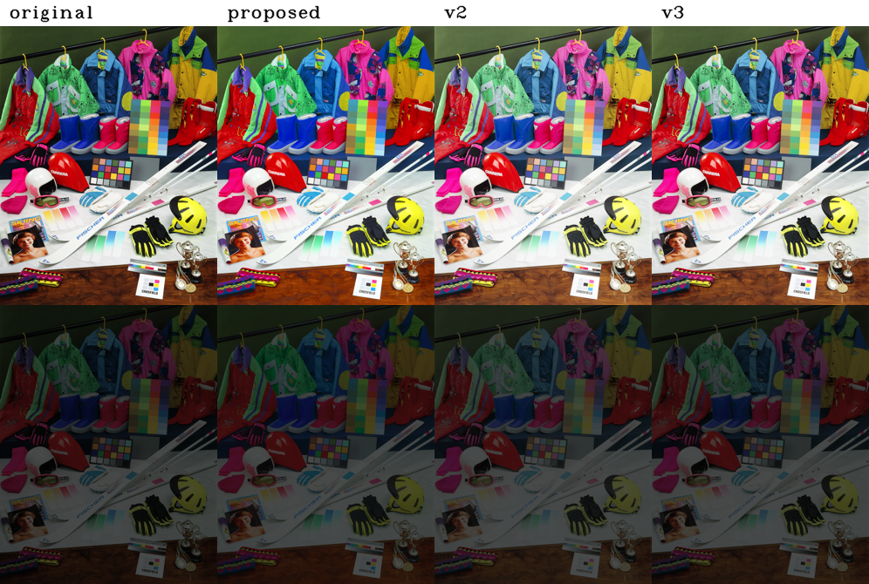
Color Correction + SLIC + CIECAM02

Slide 32
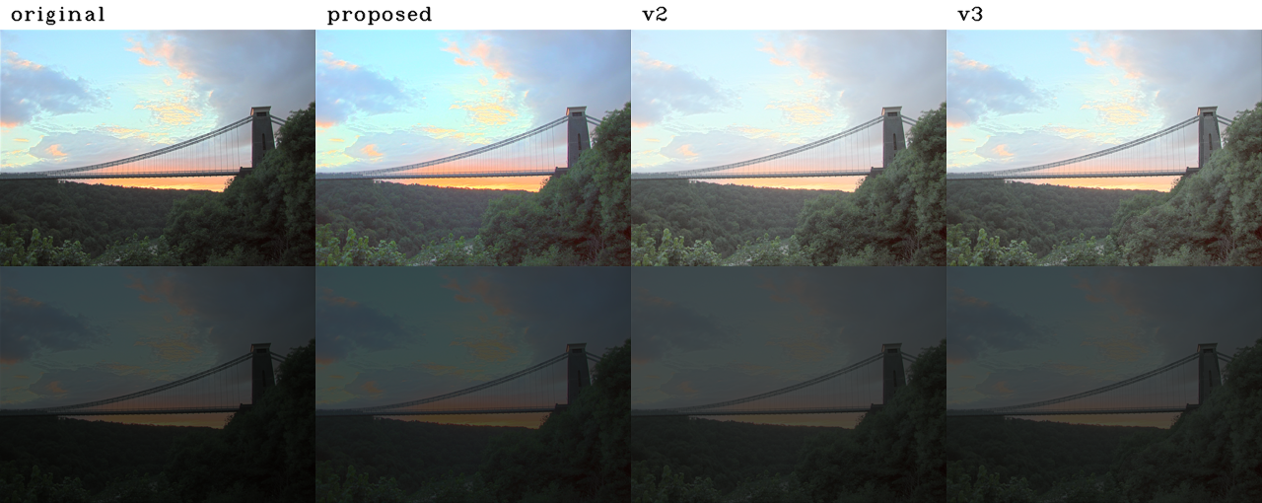
Color Correction + SLIC + CIECAM02

Slide 33
Q & A

